Slide 1

Digging Deeper Neural Networks
Dr Chris McCool

Slide 2
Time | Presentation | Practical Session
12.45am – 2.45pm | Digging Deeper: Neural networks 1. Overview of NNs 2. Convolutional NNs 3. Deep learning | NN analysis in Python
2.45pm – 3.00pm | Break
3.00pm – 4.30pm | Extended topics: NNs NNs for 2D images | NN analysis in Python
4.30pm – 5.00pm | Extended topics: NNs Deep Learning Systems Concluding remarks: Day 2 | No prac.

Slide 3
Part III Extended Topics

Slide 4
DCNNs for Practical Problems
Transfer learning and fine-tuning
Getting around the problem of data paucity
Object detection using deep CNNs
An overview of the Faster R CNN framework
Model compression
Dealing with 1000s of queries or putting them on robots/phones
Model distillation as a framework to do this

Slide 5
Transfer Learning

Slide 6
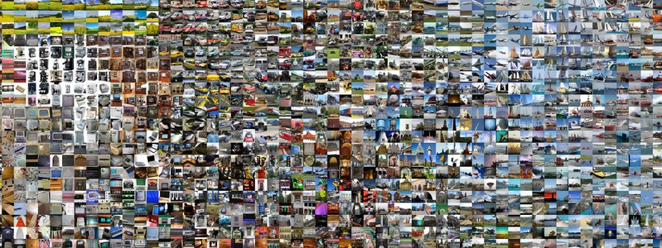
Transfer Learning and Fine-Tuning
Training DCNNs is expensive
Requires a lot of data (1,000 images of 1,000 classes)
A lot GPU processing time (weeks)

Slide 7
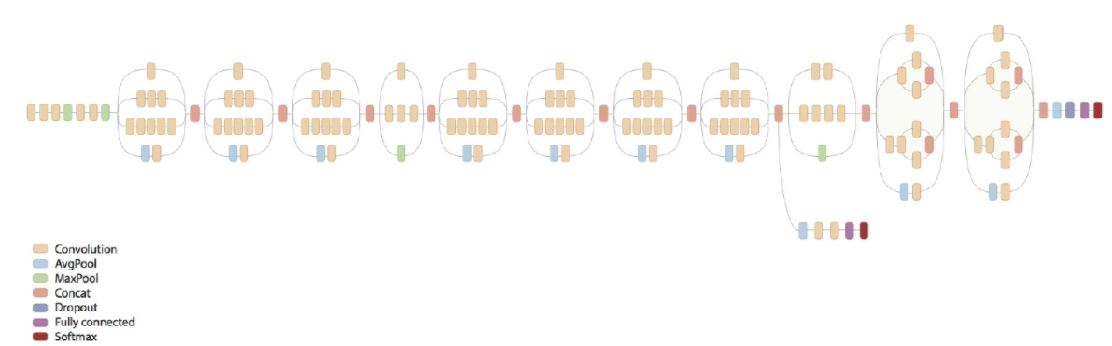
Transfer Learning and Fine-Tuning
Transfer learning is a form of model adaptation
Takes a pre-trained network
Adapts its parameters using the new data
Diverse uses

Slide 8
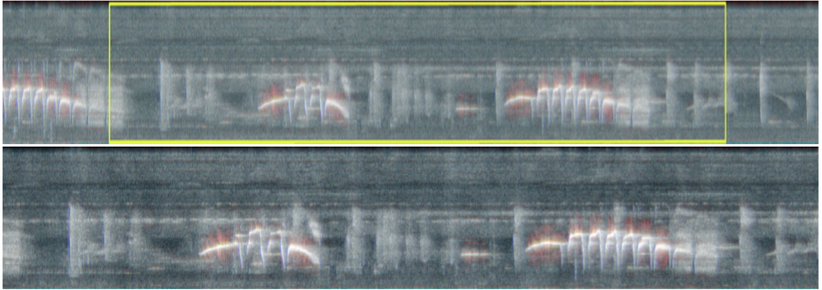
Transfer Learning and Fine-Tuning

Slide 9
Transfer Learning and Fine-Tuning
Overview of the process
Take a pre-trained network trained for a different task
Remove the last layer to suite the new task
Choose which layers to keep fixed or to retrain
Train the model as per normal

Slide 10
Transfer Learning and Fine-Tuning
Transfer learning
Rapid to train
Overcomes data paucity
Allows the use of ”complicated” DCNNs

Slide 11
Object Detection

Slide 12
Object Detection Using DCNNs
Faster RCNN
Object detection in a single network
Propose potential regions of interest
Classify regions as being the object of interest or not

Slide 13
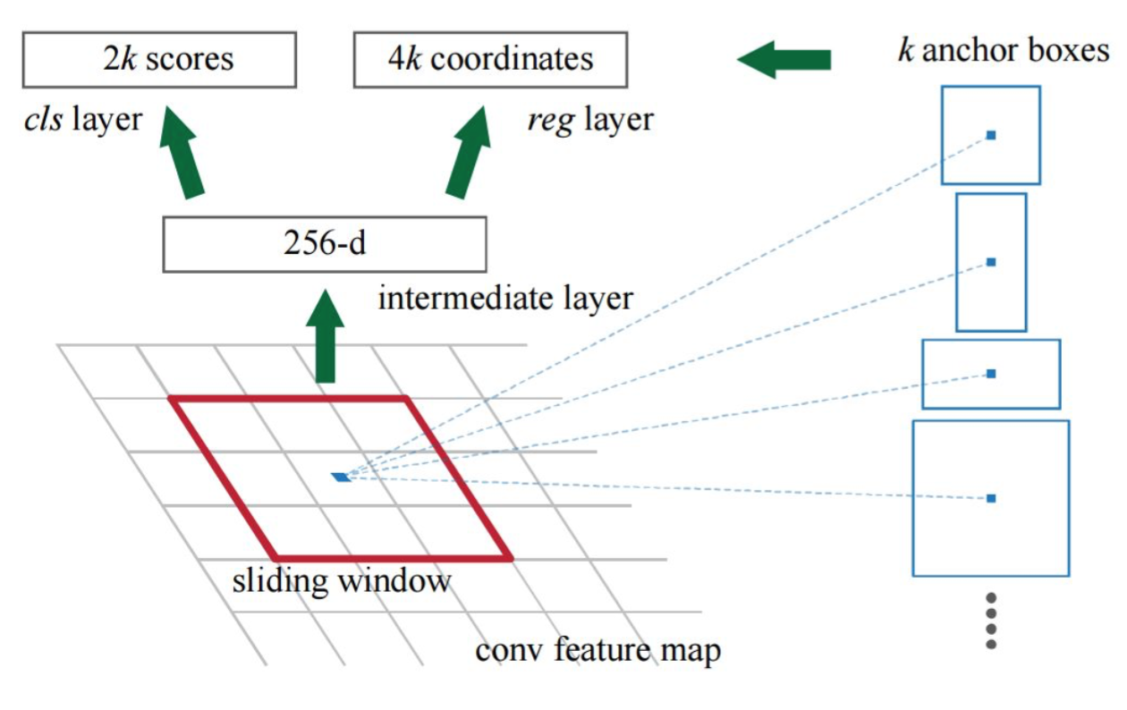
Object Detection Using DCNNs
“Object Detection in Video using Faster R-CNN”, P. Ramachandran

Slide 14
Model Compression

Slide 15
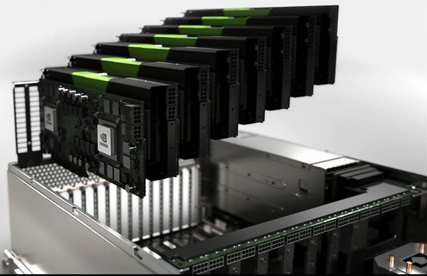
Model Compression
Deep CNNs require specialised hardware to train
Also require similar hardware to run
Classify an image
How can we do this on a robot or mobile phone?
How can we do this with 1000’s of queries a second?
With a limited resource budget?

Slide 16
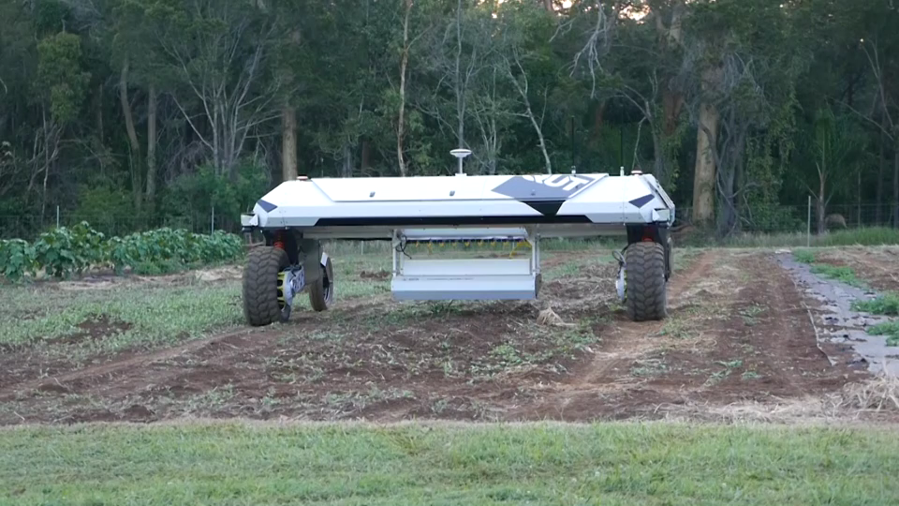

Slide 17
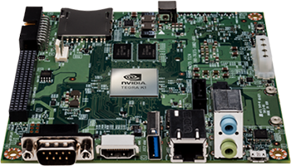
DCNNs: for resource limited environments

Slide 18
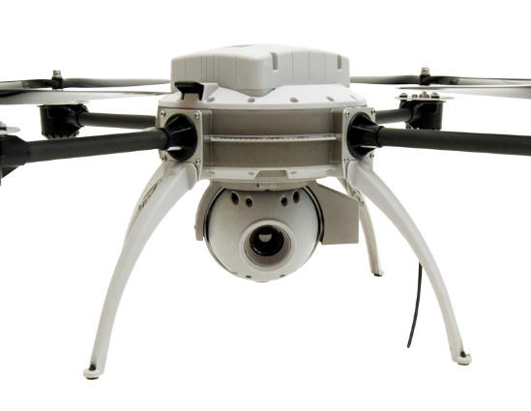
DCNNs: for resource limited environments

Slide 19
Model Compression: pruning
Anwar et al. proposed pruning the network
Retrain the network
Han et al.
Pruning
Quantization
Huffman coding
Reduce memory by 49 times
Reduced computation time by 3.5 times
S. Anwar, K. Hwang, and W. Sung, “Structured pruning of deep convolutional neural networks,” ArXiv, 2015. S. Han, M. H, and W. Dally, “Deep compression: Compressing deep neural networks with pruning, trained quantization and huffman coding,” ICLR, 2016.

Slide 20
Model Compression: distillation
“Distill” the information from a complicated model
Approximate the function represented by the complicated network
Modelling the class distribution
From Bucila et al. and more recently Hinton et al.
C. Bucila, R. Caruana, and A. Niculescu-Mizil, “Model compression,” KDD, 2006. G. Hinton, O. Vinyals, and J. Dean, “Distilling the knowledge in a neural network,” NIPS Deep Learning Workshop, 2014.

Slide 21
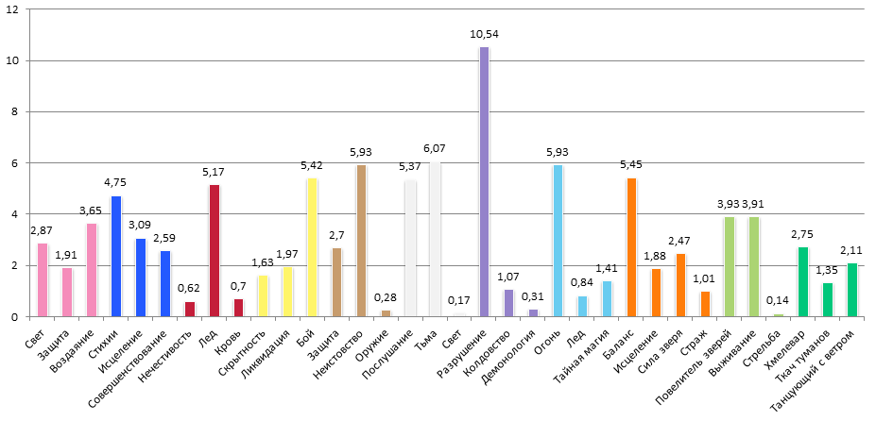

Model Compression: distillation
“Distill” the information from a complicated model
Approximate the function represented by the complicated network
Modelling the class distribution
From Bucila et al. and more recently Hinton et al.
$$y=$$
C. Bucila, R. Caruana, and A. Niculescu-Mizil, “Model compression,” KDD, 2006. G. Hinton, O. Vinyals, and J. Dean, “Distilling the knowledge in a neural network,” NIPS Deep Learning Workshop, 2014.

Slide 22




Model Compression: distillation
$$X$$
$$y$$
$$X$$
$$y^{′}$$

Slide 23
Other Trends in DCNNs
Feature Embedding
Rather than classification, learning a feature vector that is “close” to other classes
Unsupervised Approaches
Deep Auto-Encoders and Variational Auto-Encoders

Slide 24
Feature Embedding
The networks for classification learn a specific classification layer
Alternative: use the method to learn an embedding

Slide 25
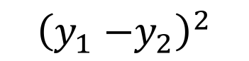
Feature Embedding
The networks for classification learn a specific classification layer
Alternative: use the method to learn an embedding
Use “pairs” of images
$${\left(y_{1}{−y}_{2}\right)}^{2}$$

Slide 26
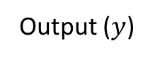
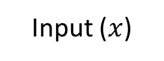
Variational Auto-Encoders
Aim
Produce a generative model
Previously more of a memory system
Constrain the network to produce latent vectors that follow a Gaussian distribution
n₂
n₁
n₁
Input ($x$)
Output ($y$)

Slide 27
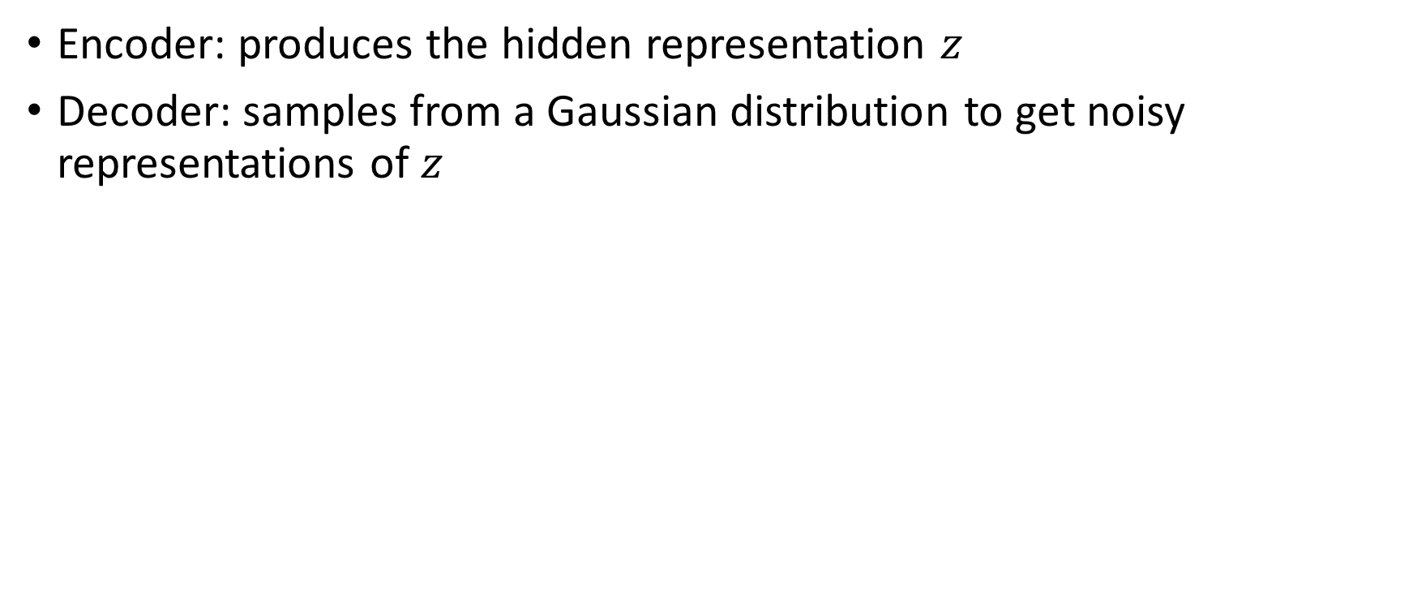
Variational Auto-Encoders
Encoder: produces the hidden representation $z$
Decoder: samples from a Gaussian distribution to get noisy representations of $z$
n₂
n₁
n₁
Input ($x$)
Output ($y$)

Slide 28
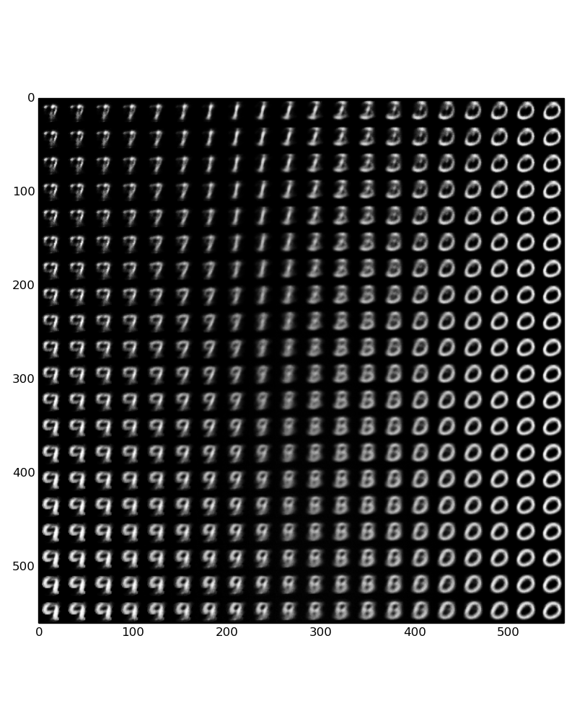
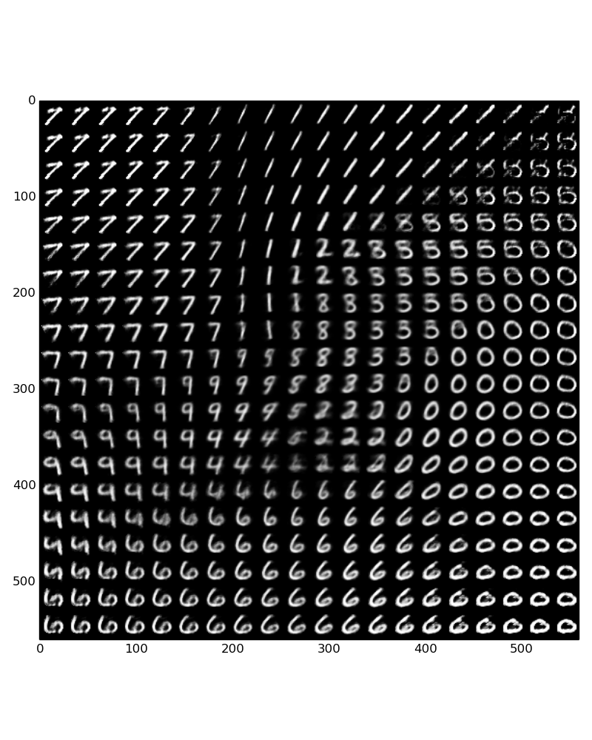
3 iterations
50 iterations

Slide 29
Recap
Briefly Discussed
Transfer learning
Object detection
Model compression
Feature embedding
Variational auto-encoders

Slide 30
Recap from earlier
Introduced Neural Networks
Trained a very simple network
Extended this to have multiple hidden layers
Changed the loss function to perform unsupervised learning (auto-encoder)
Discussed Convolutional Neural Networks
Basis for using convolutions
Coded up and trained two CNNs
Motivation for using Deep CNNs
More advanced architectures

